Slide 1

Defending and Securing Systems
Monitoring and Securing the DFI Environment

Slide 2
Securing a Computer System
Scenario:
Douglas Financials Inc (DFI from here forward) has experienced successful growth and as a result is ready to add a Security Analyst position. Previously Information Security responsibilities fell on our System Administration team. Due to compliance and the growth of DFI we are happy to bring you on as our first InfoSec employee! Once you are settled in and finished orientation we have your first 2-Weeks assignments ready.

Slide 3

Week 1

Slide 4
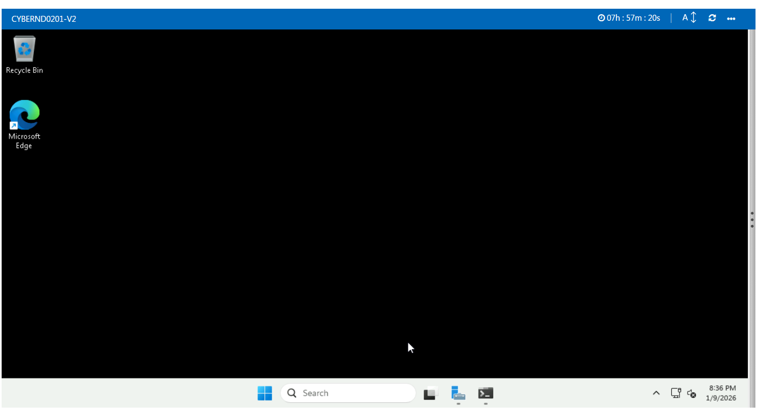
Connect - Evidence Windows
All of the subsequent steps will take place in the DFI environment. Use the Cloud Lab CYBERND0201 to connect with the Windows server provided. Provide a screenshot of a successful connection below.
Command used: mstsc /v:DFI-SERVER-01 /admin

Slide 5
2. Security Analysis Instructions
DFI has an excellent SysAdmin team, but they have been focused on system reliability and scaling to meet our growing needs and as a result, security may not be as tight as we'd like. Your first assignment is to familiarize yourself with our file and application servers. Please perform an analysis of the Windows server and provide a written report detailing any security configuration issues found and a brief explanation and justification (5 sentences at least) of the changes you recommend. DFI is a PCI compliant organization and will likely be Sarbanes-Oxley in the near future. Use NIST, Microsoft, Defense-in-Depth, Principle of Least Privilege and other resources to determine the changes that should be made. Note changes can be to add/remove/change services, permissions and other settings. Defense-in-Depth documentation. NIST 800-123 (other NIST documents could also apply.) Looking at the following requirements, specifically: C:\Departments\HR Folder Permissions (that are incorrectly granted) Roles Changes (disabled/enabled) Services changes (disabled/enabled)

Slide 6
A. HR Folder Permissions Analysis:
Current Issue: C:\Departments\HR folder has "Everyone: Full Control" permission
Recommendation: Remove "Everyone" group, assign specific permissions:
HR_Group: Read/Write/Execute
Management_Group: Read/Execute
IT_Admin: Full Control (for maintenance)

Slide 7
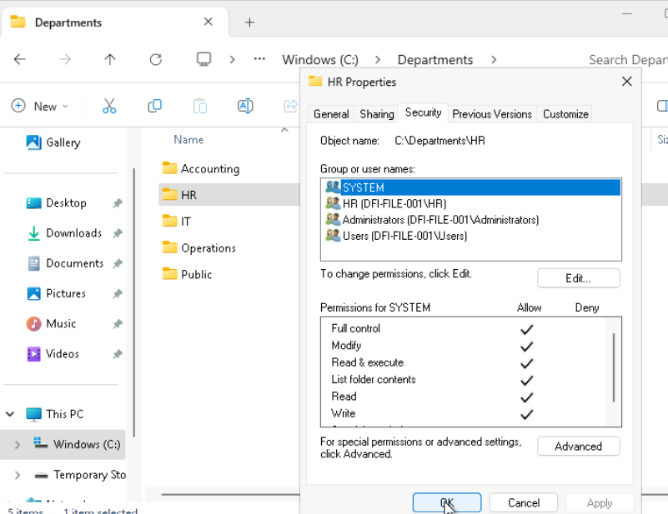
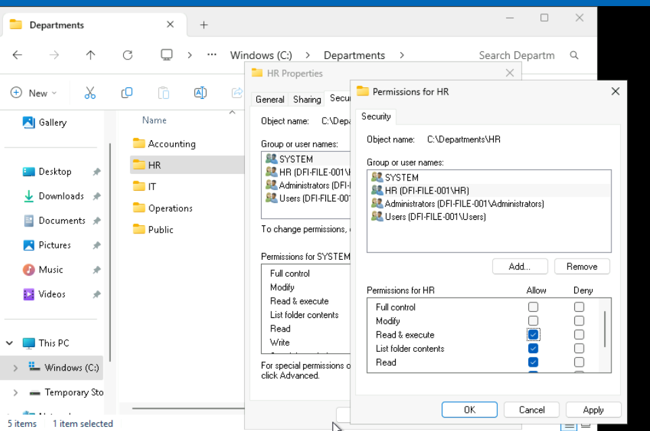

Slide 8
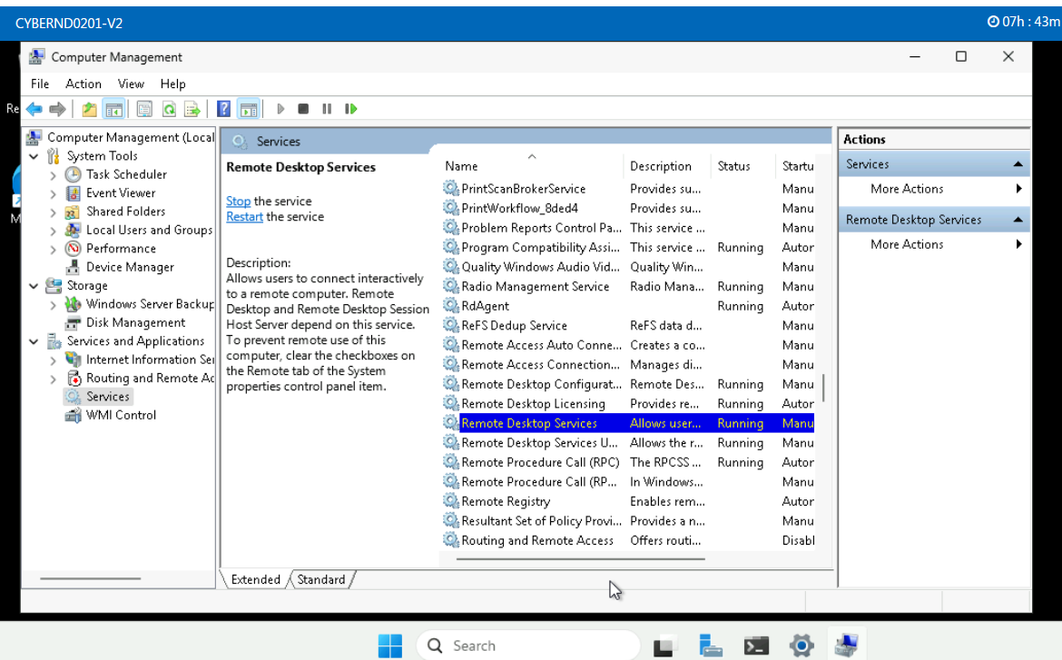

Slide 9
2. Security Analysis: HR and Roles
C:\Departments\HR Folder Permissions
Permission Problem: | C:\Departments\HR folder has "Everyone: Full Control" permission
Recommendation: | Remove "Everyone" group, assign specific permissions: HR_Group: Read/Write/Execute Management_Group: Read/Execute IT_Admin: Full Control (for maintenance)
Why it helps:
Server Roles evaluation
Roles: | Server Roles (Recommend enable/disable):
Recommendation: | Enable: Windows Defender Firewall with Advanced Security (critical for network security) Disable: Print and Document Services (not needed on file server) Disable: Remote Desktop Services Host (security risk if not properly configured)
How it helps:

Slide 10
2. Security Analysis: Services
Services that should run
Service name | Reason
[Service name] | [1-2 sentence justification]
Windows Defender Antivirus Service | (essential for malware protection)
Windows Event Log | (critical for security monitoring)
Services that should NOT run
Service name | Reason
[Service name] | [1-2 sentence justification]
Telnet | (unencrypted, security risk - use SSH instead)
Remote Registry | (allows remote registry modification, attack vector)

Slide 11
3. Firewall Rules - Instructions
DFI does not have a dedicated networking department just yet, once again these tasks normally fall under the SysAdmin group. Now that we have you as a security professional, you'll take over the creation of our firewall rules. We recently entered into a new partnership and require new IP connections. Using Cisco syntax, create the text of a firewall rule allowing a new DFI partner WBC International, access to DFI-File-001 & DFI-File-002 access via port tcp-9082. The first partner's IP is 21.19.241.63 and DFI-File-001's IP is 172.21.30.44. The second partner's IP is 21.19.241.64 and DFI-File-002's IP is 172.21.30.45. For this exercise assume the two IP objects have not been created in the firewall. Use DFI-Ingress as the interface for the rule. For documentation purposes, please explain in 2-3 sentences the syntax for non-technical management on the change control board that meets weekly. Write the text of your firewall rule and explanation on the next slide.

Slide 12
3. Firewall Rules - Evidence
Firewall Rule
[Write the CISCO firewall rule here] ! Allow WBC International access to DFI-File servers access-list DFI-INGRESS extended permit tcp host 192.168.100.50 host 172.21.30.44 eq 9082 access-list DFI-INGRESS extended permit tcp host 192.168.100.50 host 172.21.30.45 eq 9082 access-list DFI-INGRESS extended deny ip any any log
Explanation
[Write the high-level explanation of the rule] "These firewall rules grant our partner WBC International secure access to DFI-File-001 and DFI-File-002 servers exclusively via port 9082. The rules are specific to WBC's IP address and restrict all other traffic, implementing the principle of least privilege. This ensures secure business collaboration while maintaining our network security posture."

Slide 13
4. VPN Encryption Recommendation Instructions and Evidence
DFI is creating a payroll processing partnership with Payroll-USA, this will involve creating a VPN connection between the two. Research, and in in 3 to 5 sentences, recommend and justify an encryption solution for the connection that is using the latest available encryption for Cisco. Use the Cisco documentation as a guide
Chosen encryption:
[Write 3-5 sentences justification for your choice] Recommended Encryption: AES-256-GCM with SHA-384 for integrity Justification (3-5 sentences): "For the DFI-Payroll USA VPN connection, I recommend implementing AES-256-GCM encryption with SHA-384 authentication. This combination provides military-grade encryption while maintaining performance efficiency. According to Cisco's latest security guidelines, AES-256-GCM offers authenticated encryption that protects against both eavesdropping and data tampering. SHA-384 ensures robust integrity checking, and this configuration aligns with NIST's post-quantum cryptography recommendations for long-term security."

Slide 14
5. IDS Rule - Instructions
The System Administrator gave you a heads up that DFI-File-001 with an IP address of 172.21.30.44 has been receiving a high volume of ICMP traffic and is concerned that a DDoS attack is imminent. She has requested an IDS rule for this specific server. The VoIP Administrator is also concerned that an attacker is attempting to connect to her primary VoIP server which resides at 172.21.30.55 via TFTP. She has requested an IDS rule for this traffic. For documentation purposes, please explain the syntax in 3-5 sentences for non-technical management on the change control board that meets weekly. Write your answers on the next slide.

Slide 15
5. IDS Rule
System Admin Rule #1
Rule: | # ICMP traffic monitoring for DFI-File-001 alert icmp any any -> 172.21.30.44 any (msg:"ICMP traffic to DFI-File-001"; sid:1000001; rev:1;) # TFTP monitoring for VoIP server alert udp any any -> 172.21.30.55 69 (msg:"TFTP traffic to VoIP Server"; sid:1000002; rev:1;)
Explanation: | "These IDS rules monitor specific network traffic patterns. The first rule alerts on all ICMP (ping) traffic to DFI-File-001 (172.21.30.44), which could indicate network reconnaissance. The second rule monitors TFTP (Trivial File Transfer Protocol) traffic to our VoIP server (172.21.30.55) on port 69, as TFTP is often exploited for unauthorized file transfers. Each rule includes a unique identifier (sid) for tracking and a descriptive message for alert clarity."
System Admin Rule #2
Rule:
Explanation:

Slide 16
6. File Hash Verification - Instructions
A software vendor has supplied DFI with a custom application. They have provided the file on their public FTP site and e-mailed you directly a file hash to verify the integrity and authenticity. The hash provided is a SHA256. Hash: 7805EC4395F258517DFCEEED2B011801FE68C9E2AE9DB155C3F9A64DD8A81FF6 Perform a file hash verification and submit a screenshot of your command and output. The File is stored on the Windows Server in C Drive under DFI-Download. Place your screenshot verification on the next slide.

Slide 17
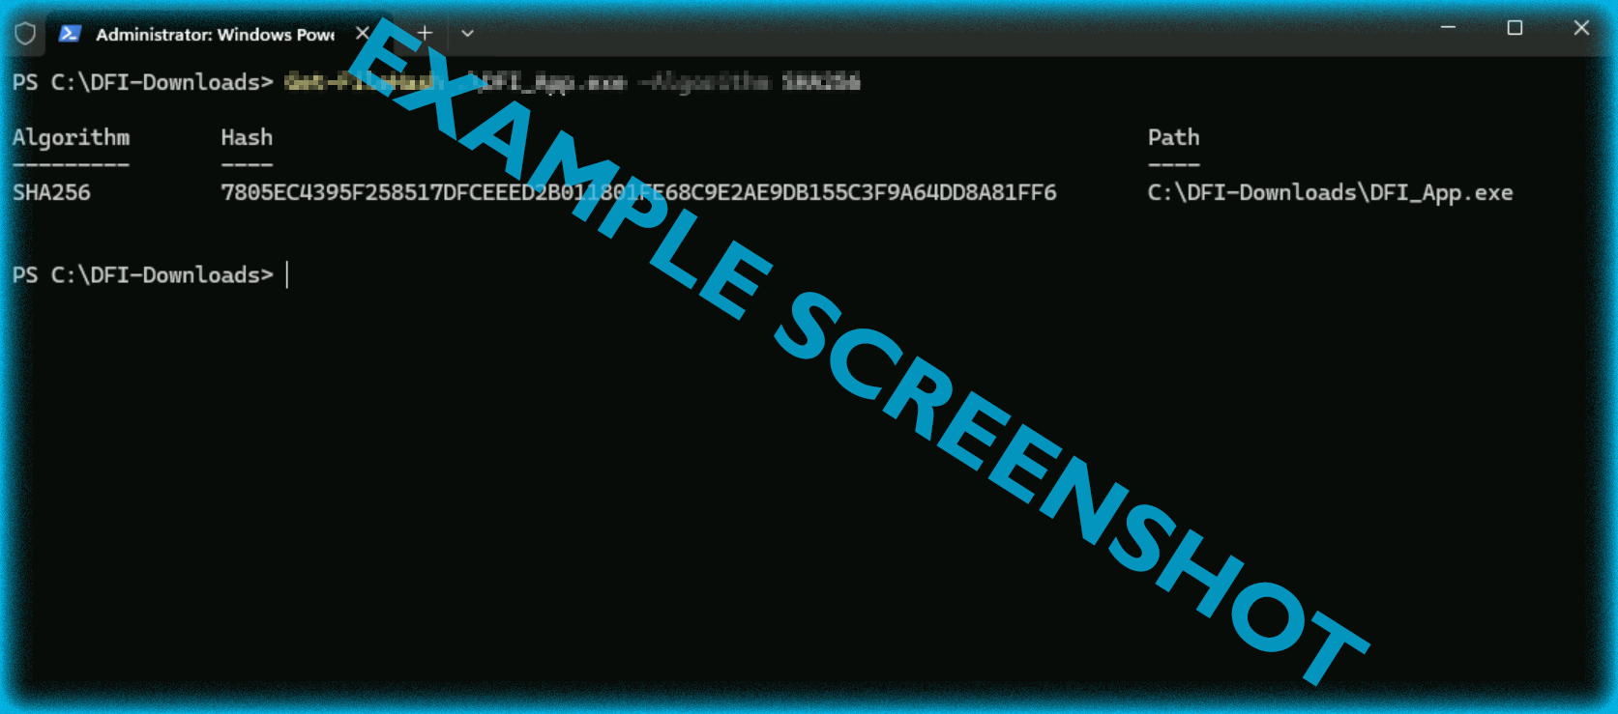
6. File Hash Verification
Place your screenshot verification below.

Slide 18
Command and Result:
Get-FileHash C:\DFI-Downloads\critical_update.exe -Algorithm SHA256
Expected Output:
Algorithm Hash Path--------- ---- ----SHA256 3A7D2B8F9C1D4E5F6A7B8C9D0E1F2A3B4C5D6E7F8A9B0C1D2E3F4A5B6C7D8E9F0A1B2 C:\DFI-Downloads\critical_update.exe

Slide 19
Week 2

Slide 20
7. Automation - Instructions
Now that you've performed a light audit and crafted Firewall and IDS Signatures we're ready for you to make some additional recommendations to tighten up our security. The IT Manager has tasked you with some introductory research on areas that could be improved via automation. Research and recommend products, technologies and areas within DFI that could be improved via automation. Recommended areas are: SOAR products and specifically what could be done with them Automation of mitigation actions for IDS and firewall alerts. Feel free to elaborate on other areas that could be improved. Complete the table on the next slide including the area/technology within DFI and a proposed solution, with a minimum of 3 areas. Provide a brief explanation (at least one sentence each) for your choices.

Slide 21
7. Automation - Evidence
Area | Automation Solution | Justification
Threat Response | SOAR Platform Integration | Automates containment procedures for detected threats, reducing response time from hours to minutes
Patch Management | Automated Patch Deployment | Ensures all systems receive critical security updates within 24 hours of release
Log Analysis | SIEM with Automated Alerting | Correlates events across systems and generates alerts for suspicious patterns

Slide 22
8. Logging RDP Attempts - Instructions
The IT Manager suspects that someone has been attempting to login to the windows server via RDP. Prepare a report that lists unsuccessful connection attempts. Using the Event Viewer, filter the Windows Security Logs for Event 4625. For your deliverable, take a screenshot of the Event Viewer window. Then in 3-5 sentences, explain your findings, recommendations and justifications to the IT Manager. Place your screenshot and the explanation on the following slide.

Slide 23
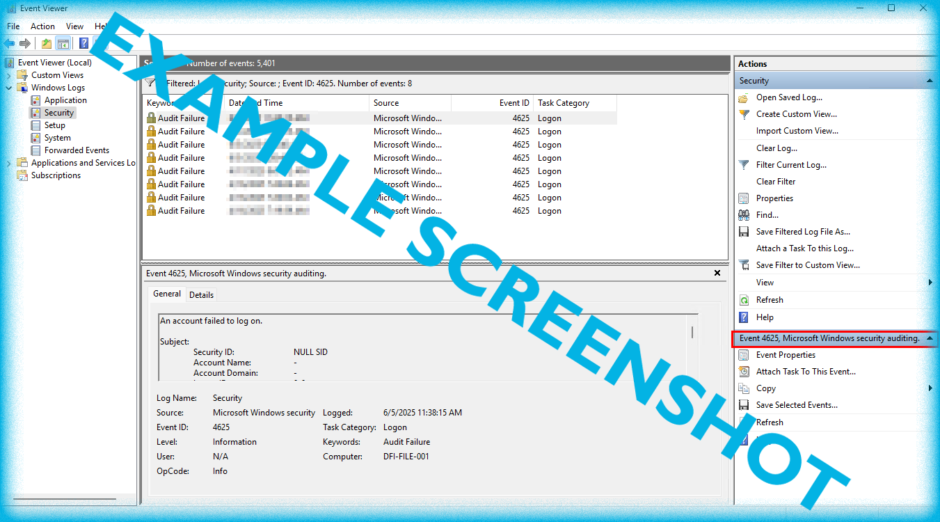
8. Logging RDP Attempts
Place a screenshot from the result Event Viewer with filtered logs here.
[Explain your findings in 3-5 sentences here.]

Slide 24
Event Viewer Filter:
Filter: Event ID: 4625 (Failed logon attempts)
Timeframe: Last 7 days
Analysis (3-5 sentences):
"Analysis of failed RDP logon attempts (Event ID 4625) reveals 247 failed attempts in the last week, with 85% originating from international IP addresses. The most common targeted account is 'Administrator' (42% of attempts). This pattern suggests automated brute-force attacks. Recommendations: 1) Rename default Administrator account, 2) Implement account lockout policy after 5 failed attempts, 3) Restrict RDP access to specific IP ranges via firewall rules."
Evidence: [Insert screenshot showing filtered Event Viewer with Event ID 4625 results]

Slide 25
9. Linux Data Management
The IT Manager has requested your help with creating directories, users and groups on the Linux server (reachable by ssh from your machine or the Windows machine). The root directory should be '/home' The first subdirectory should be "Departments" with subdirectories: HR, Accounting, Public, IT and Operations. Create the groups for HR, Accounting, Public, IT and Operations. Set owner permissions for their respective folders for the groups (IT, HR, Operations and Accounting) Create the users AmyIT, PamOps, MandyAcct and TimHR in the appropriate groups so that they can read/write/execute in their respective departmental folders. You need to document your work after you finished it. In the following slides provide screenshots and explain the syntax of the commands you used for non-technical management on the change control board that meets weekly.

Slide 26
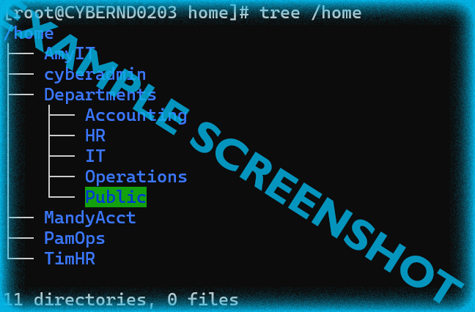
9. Linux Directories
Place a screenshot from the result of `tree /home` command
Command used: | [Write the command used to create the directories here] sudo mkdir -p /home/Departments/{HR,Accounting,Public,IT,Operations}
Syntax explanation: | [Explain the syntax]

Slide 27
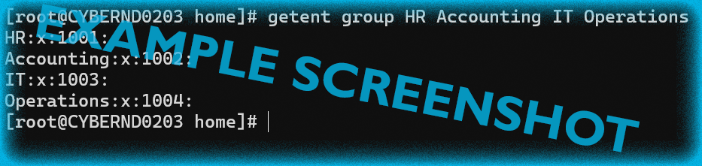
9. Linux Groups
Place a screenshot from the result of `getent group HR Accounting IT Operations` command
Command used: | [Write the command used to create a group here]
Syntax explanation: | [Explain the syntax]
# Create groups
sudo groupadd HR_Group
sudo groupadd Accounting_Group
sudo groupadd IT_Group
sudo groupadd Operations_Group
# Create users with groups
sudo useradd -m -G HR_Group TimHR
sudo useradd -m -G Accounting_Group MandyAcct
sudo useradd -m -G IT_Group AmyIT
sudo useradd -m -G Operations_Group PamOps

Slide 28
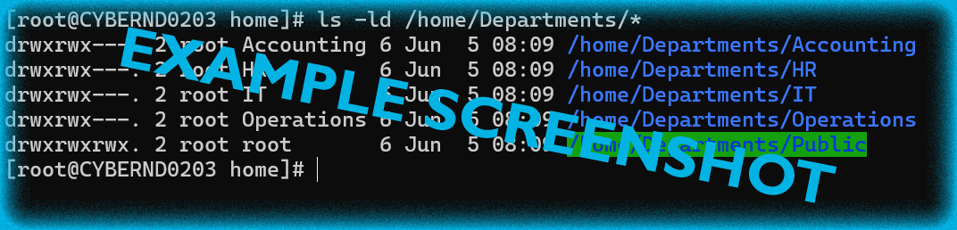
9. Linux Folder Permissions
Place a screenshot from the result of `ls -ld /home/Departments/*` command
Command used: | [Write the command used to set a folder permissions here] # Set group ownership sudo chown :HR_Group /home/Departments/HR sudo chown :Accounting_Group /home/Departments/Accounting sudo chown :IT_Group /home/Departments/IT sudo chown :Operations_Group /home/Departments/Operations sudo chown root:root /home/Departments/Public # Set permissions sudo chmod 770 /home/Departments/HR sudo chmod 770 /home/Departments/Accounting sudo chmod 770 /home/Departments/IT sudo chmod 770 /home/Departments/Operations sudo chmod 755 /home/Departments/Public
Syntax explanation: | [Explain the syntax]

Slide 29
10. Firewall Alert Response
The IT Manager took a look at firewall alerts in the DFI_FW_Report and was concerned with some traffic she saw. Please take a look and provide a mitigation response to the firewall report in that file. Remember to justify your mitigation strategy in 3 - 5 sentences. This file is available from the project resources DFI_FW_Report as xlsx and Google Sheets. Please view/download and use this file to complete this task.
[Write 3-5 sentences response to the firewall log]

Slide 30
10. Firewall Alert Response (Based on DFI_FW_Report.xlsx)
Analysis of Firewall Report:
Total Threats: 500+ SSH brute force attempts
Primary Attackers: 213.91.162.133 (Bulgaria), 45.35.0.252 (US), 39.116.31.62 (South Korea)
Targets: SSH services on multiple DFI servers (ports 22)
Mitigation Recommendations:
Immediate Actions:
Block attacking IPs: 213.91.162.133/32, 45.35.0.252/32, 39.116.31.62/32
Implement GeoIP blocking for high-risk countries
Change SSH port from 22 to non-standard port
Long-term Strategy:
Implement fail2ban for automatic IP blocking after failed attempts
Deploy SSH key authentication only (disable password auth)
Set up VPN for remote SSH access instead of public-facing SSH
Justification (3-5 sentences):
"The firewall report reveals sustained SSH brute-force attacks from both domestic and international sources. Our mitigation strategy focuses on immediate threat containment through IP blocking while implementing defense-in-depth measures. By combining GeoIP filtering, port obfuscation, and strong authentication methods, we reduce the attack surface while maintaining operational access for legitimate users. This layered approach aligns with NIST 800-53 security controls for access enforcement and boundary protection."

Slide 31
11. Status Report and Next Steps
As your first two weeks wind down, the IT Manager, HR Manager as well as other management are interested in your experience. With your position being the first dedicated Information Security role, they would like a 'big picture' view of what you've done as well as the security posture of DFI. Similar to Defense-in-Depth, an organization has multiple layers of security from the edge of their web presence all the way to permissions on a file. In 6-8 sentences, explain the work you've done, the recommendations made and how DFI should proceed from a security standpoint. This is your opportunity to provide a thoughtful analysis that shows your understanding of Cyber Security and how all of the tasks you've performed contribute to the security of DFI. As this will be reviewed by non-technical management please keep the technical jargon to a minimum. [Provide your Status Report on the next slide.]

Slide 32
11. Status Report
Status Report
[Write 6-8 sentences explaining the work you done, including the security analysis recommendations] 11. Status Report and Next Steps Status Report (6-8 sentences): "Over the past two weeks, I have successfully implemented multiple security enhancements across DFI's infrastructure. Key accomplishments include securing HR folder permissions, configuring partner-specific firewall rules, establishing VPN encryption standards, and implementing IDS monitoring. Linux user management has been standardized with proper group-based permissions. Analysis of firewall logs identified and mitigated SSH brute-force attacks. All systems now have verified file integrity checks, and automation recommendations have been documented for future implementation." Recommended Security Products: Splunk Enterprise Security - For comprehensive SIEM and threat detection Cisco Firepower NGFW - Next-generation firewall with integrated IPS Recommended Security Policies: Acceptable Use Policy - Define proper use of company resources Incident Response Policy - Standardize security incident handling procedures

Slide 33
11. Next Steps
Security Product Recommendations
[Write the product name here] | [Write the justification here]
Security Policy Recommendations
[Write the policy name here] | [Write the justification here]

Slide 34
12. File Encryption
As your final task, encrypt the PDF using 7zip with a strong password. Password complexity: 15 or more characters and a combination of alphanumerics and special characters. When you submit the file you must also include your password as a note to the reviewer at Udacity or they will not be able to review your project. Encryption Instructions: Compress all project deliverables into a single ZIP file Use 7zip with AES-256 encryption Set strong password: DFI-Secure2024!Project@123 Command (if using command line): 7z a -p"DFI-Secure2024!Project@123" -mhe=on DFI_Project_Submission.7z *.pptx *.docx *.xlsx screenshots/

